Slide 1
20190128
Lee Jong Geon

Slide 2
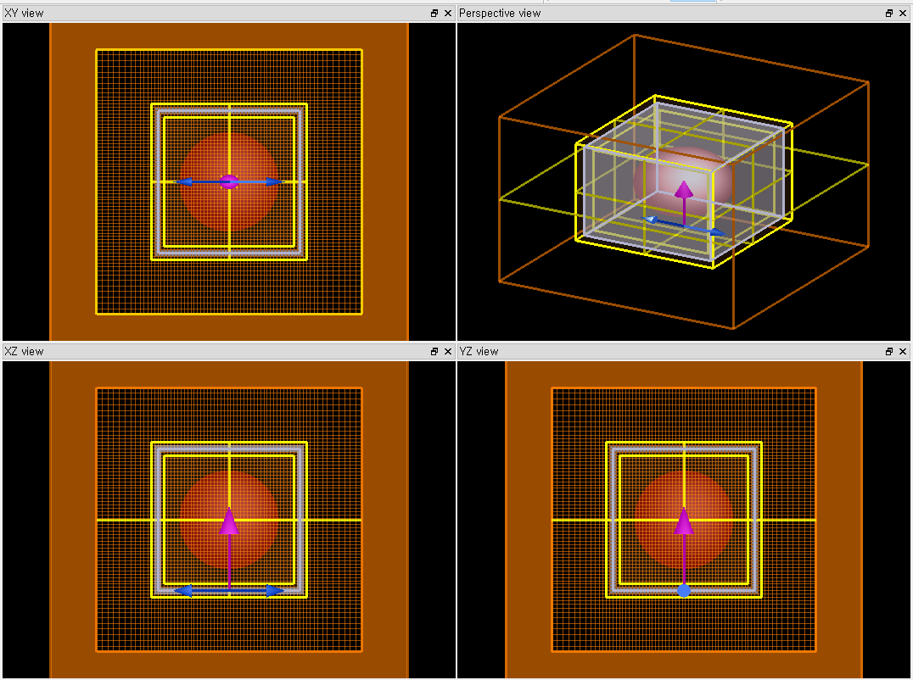
Mie Scattering
Sphere radius = 10 - 1000 μm
Material: Si
Source: 0.2-1.2 THz z-axis

